Slide 1

Bank Loan Performance Insights
Data-Driven Strategies for Enhanced Financial Services
Bikash Deb

Slide 2
Enhancing Lending Strategies with Data
In the face of dynamic financial landscapes, our objective was to dissect loan-related metrics to bolster the bank's lending activities and drive informed decision-making.

Slide 3
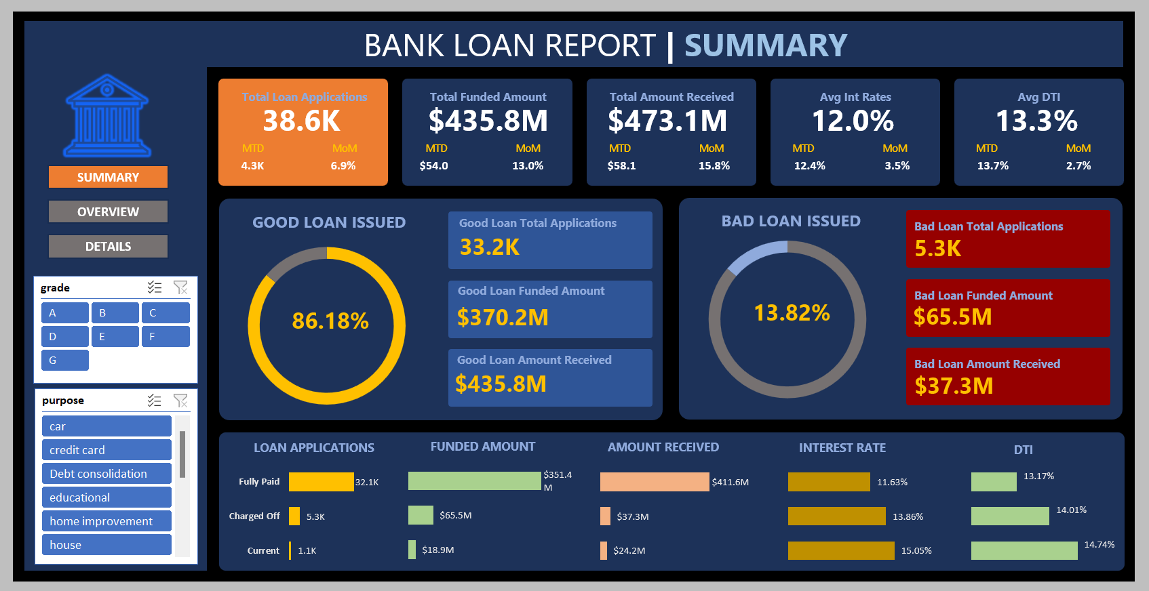

Slide 4
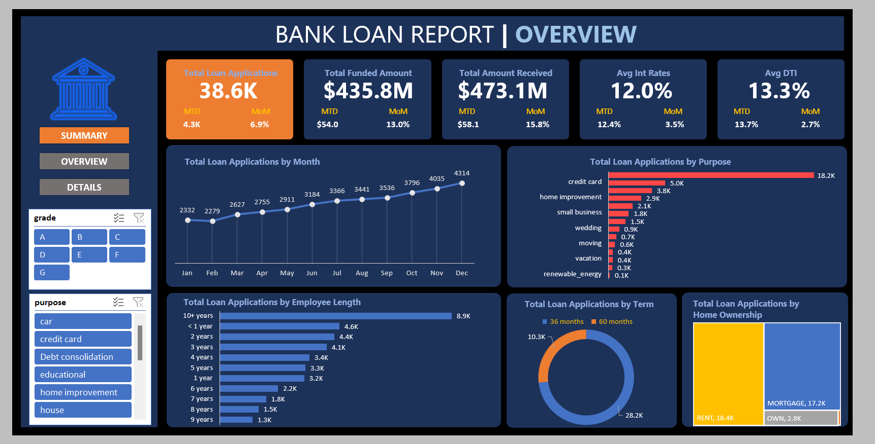

Slide 5
Dashboard Driven Discoveries
Increasing loan applications signal market trust and product appeal.
Profitable interest returns with a $37.3M gap between funded and received amounts.
Debt consolidation emerges as the primary purpose for loans, indicating a market need for managing financial burdens.

Slide 6
Insightful Metrics for Informed Decisions
Consistent loan growth with a year-end spike – opportunity for targeted year-end offers.
Higher recovery on 'good' loans underscores effective credit assessment.
Variation in interest rates between good and bad loans can refine risk pricing models.

Slide 7
Strategizing with Purpose
Debt Consolidation Focus: Develop specialized products tailored to the top loan purpose.
Risk Mitigation: Further analyze 'bad loan' indicators to tighten risk assessment protocols.
Seasonal Readiness: Prepare capital and resources for expected application influxes at year-end.

Slide 8
Thank You

